Slide 1
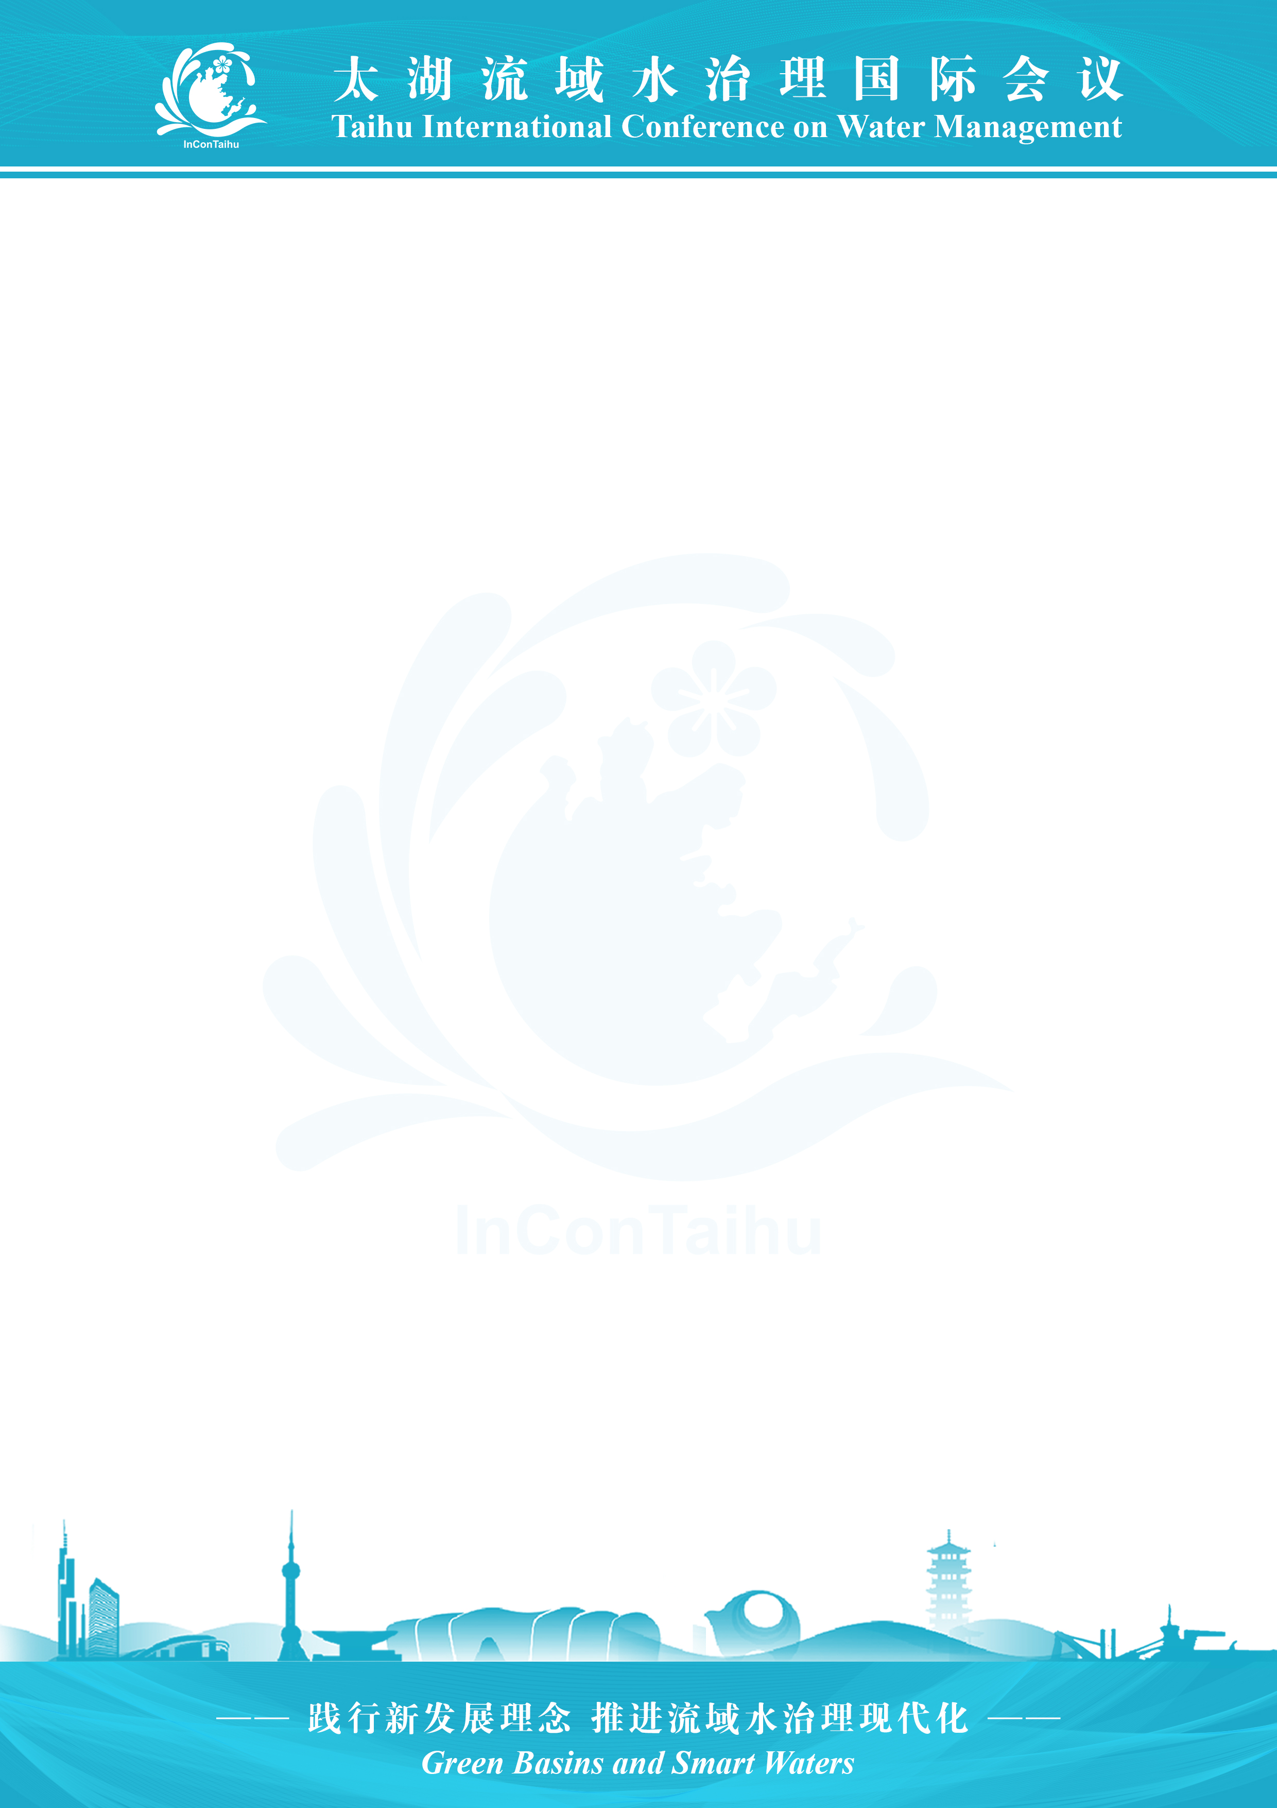
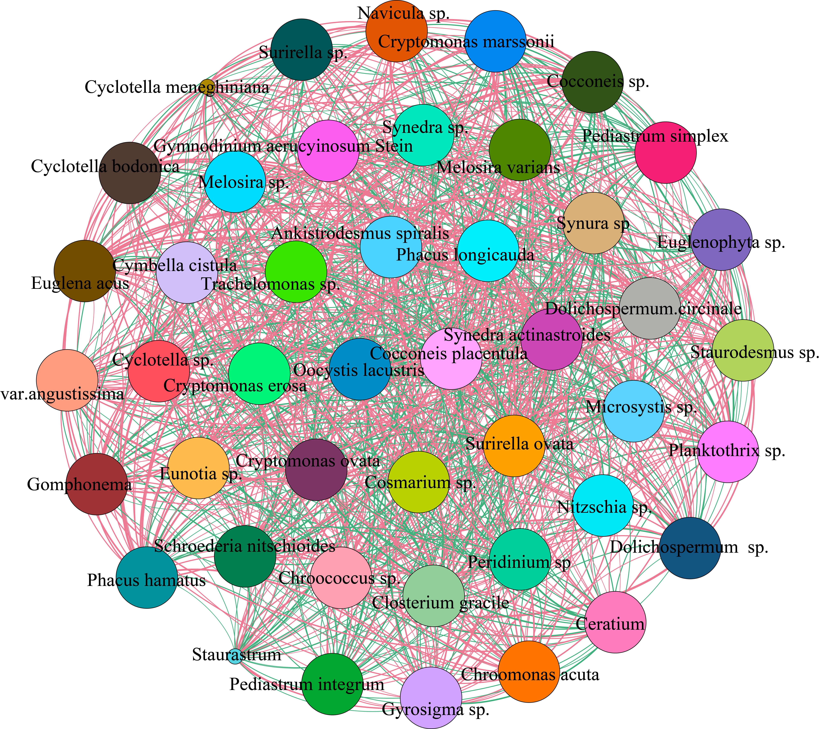

Research and Application of Technology for Building Urban River and Lake Intelligent Management System（font Calibri, size 80）
NI SHU, MA RUOXI
Nanjing Hydraulic Research Institute ( font Arial, size 44)
Introduction ( font Arial, Maxium size 54)
Multi-level data substrate construction. Construction of regulation model wisdom core.
Model knowledge base construction. ( font Arial, Maximum size 42 )
Providing intelligent solutions for urban river and lake governance and long-term management and care is an important way to accelerate the improvement of modern water governance system. ( font Arial, Maximum size 42 )
Methods ( font Arial, Maxium size 54)
On the basis of making full use of the existing data including water level, water quality and video data, the system realises intelligent scheduling of water projects in the park, dynamic supervision of cyanobacteria prevention and control process.( font Arial, Maximum size 42 )
Picture accuracy not less than 300dpi
Figure 2 Monthly biomass of phytoplankton dominant functional groups ( font Arial, Maximum size 36 )
(a)
(b)
Conclusions( font Arial, Maxium size 54)
The application of the system not only improves the precision and efficiency of flood control and drainage, but also plays a significant role in cyanobacteria prevention and control, ecological protection and other aspects.( font Arial, Maximum size 42 )
Picture accuracy not less than 300dpi
Contact Information( font Arial, Maxium size 54)
Figure 1 (a). Phytoplankton covariance network diagram; (b) phytoplankton compositional algal density map of Xitang River ( font Arial, Maximum size 36 )
InConTaihu2024@nhri.cn
https://www.incontaihu.com.
( font Arial, Maximum size 42 )
Results ( font Arial, Maxium size 54)
Multi-dimensional and three-dimensional sensing system construction. ( font Arial, Maximum size 42 )
Issue: River/lake Health & Riparian Communities
Number:0001
( font Calibri, Maximum size 52 )

